Slide 1
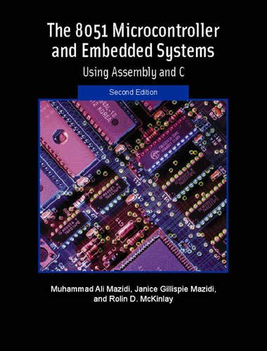
THE 8051
MICROCONTROLLER & Embedded Systems
Muhammad Ali Mazidi, Janice Mazidi
& Rolin McKinlay

Slide 2
8051 TIMER PROGRAMMING
IN ASSEMBLY AND C
Chapter 9

Slide 3
Objectives
Upon completion of this chapter, you will be able to:
>> List the timers of the 8051 and their associated registers
>> Describe the various modes of the 8051 timers
>> Program the 8051 timers in Assembly and C to generate time delays
>> Program the 8051 counters in Assembly and C as event counters

Slide 4
Objectives
Describing two timers/counters in 8051,
Section 9.1, how these timers are used to generate time delays,
Section 9.2, how these timers are used as event counters,
Section 9.3, using C language to program the 8051 timers

Slide 5
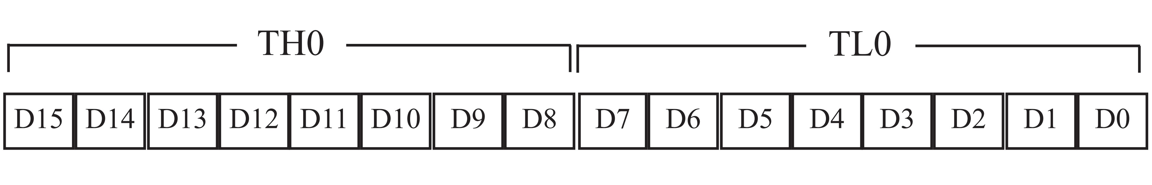
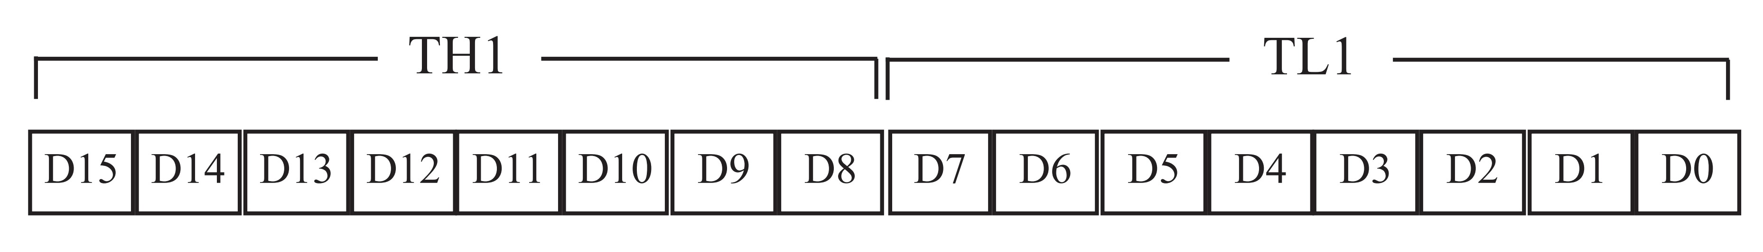
Figure 9-1. Timer 0 Registers
Figure 9-2. Timer 1 Registers

Slide 6
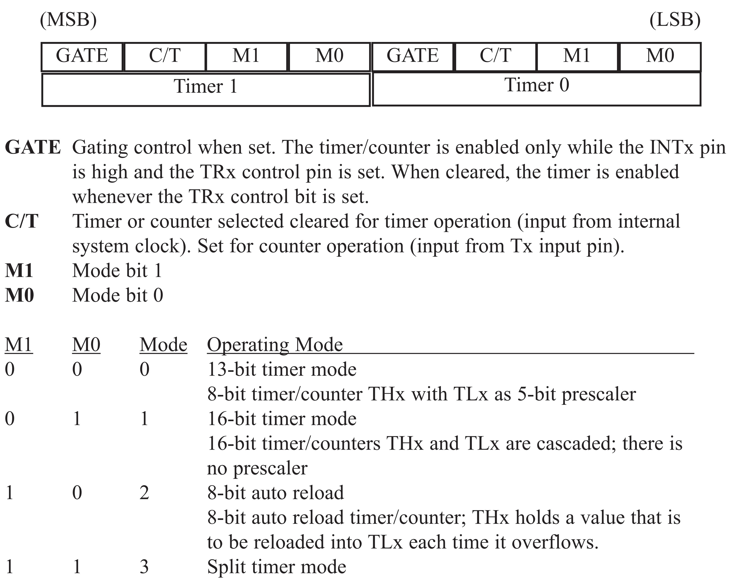
Figure 9-3. TMOD Register

Slide 7
Example 9-1
Indicate which mode and which timer are selected for each of the following.
(a) MOV TMOD,#01H (b) MOV TMOD,#20H (c) MOV TMOD,#12H
Solution:
We convert the values from hex to binary. From Figure 9-3 we have:
(a) TMOD = 00000001, mode 1 of Timer 0 is selected.
(b) TMOD = 00100000, mode 2 of Timer 1 is selected.
(c) TMOD = 00010010, mode 2 of Timer 0, and mode 1 of
Timer 1 are selected.

Slide 8
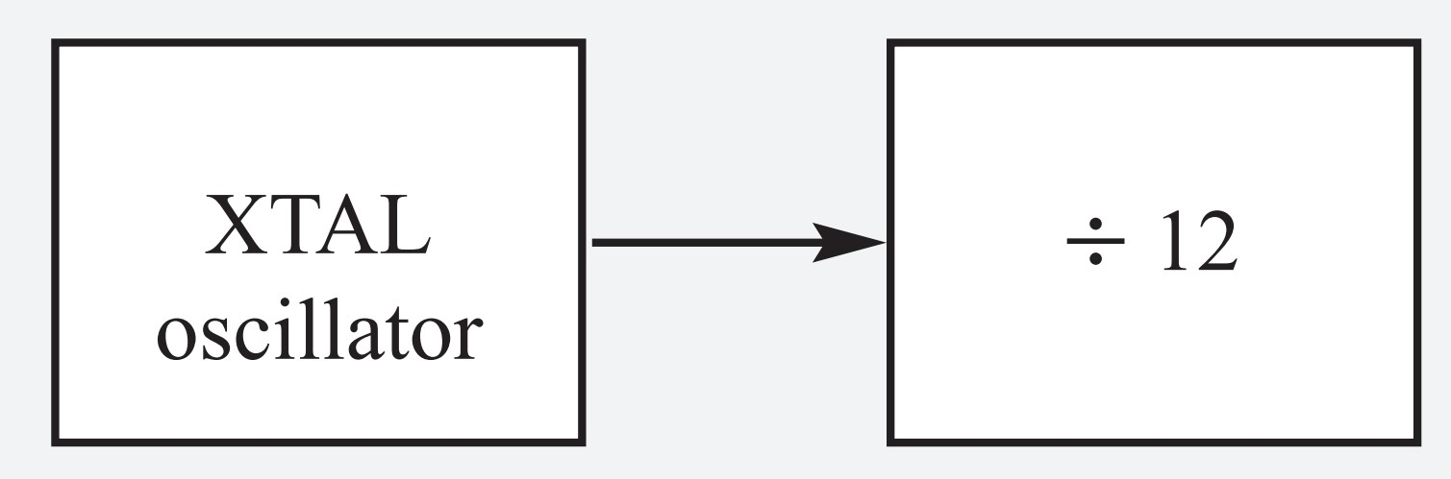
Example 9-2
Find the timer’s clock frequency and its period for various 8051-based systems, with the following crystal frequencies.
(a) 12 MHz (b) 16 MHz (c) 11.0592 MHz
Solution:
NOTE THAT 8051 TIMERS USE 1/12 OF XTAL FREQUENCY, REGARDLESS OF
MACHINE CYCLE TIME.
(a) 1/12 x 12 MHz = 1 MHz and T = 1/1 MHz = 1 µs
(b) 1/12 x 16 MHz = 1.333 MHz and T = 1/1.333 MHz = .75 µs
(c) 1/12 x 11.0592 MHz = 921.6 kHz;
T = 1/921.6 kHz = 1.085 µs

Slide 9
Example 9-3
Find the value for TMOD if we want to program Timer 0 in mode 2, use 8051 XTAL for the clock source, and use instructions to start and stop the timer.
Solution:
TMOD = 0000 0010 Timer 0, mode 2,
C/T = 0 to use XTAL clock source, and
gate = 0 to use internal (software)
start and stop method.

Slide 10
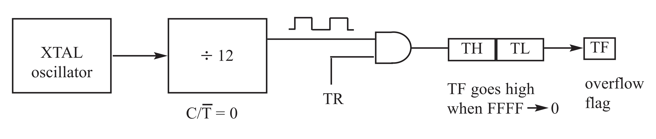
Mode 1 programming

Slide 11
Figure 9-4. Timer Delay Calculation for XTAL = 11.0592 MHz
(a) in hex
(FFFF - YYXX + 1) x 1.085 µs
where YYXX are TH, TL initial values respectively. Notice that values YYXX are in hex.
(b) in decimal
Convert YYXX values of the TH,TL register to decimal to get a NNNNN decimal number, then(65536 - NNNNN) x 1.085 µs

Slide 12
Example 9-4
In the following program, we are creating a square wave of 50% duty cycle (with equal portions high and low) on the P1.5 bit. Timer 0 is used to generate the time delay. Analyze the program.
MOV TMOD,#01 ;Timer 0, mode 1(16-bit mode)
HERE: MOV TL0,#0F2H ;TL0 = F2H, the Low byte
MOV TH0,#0FFH ;TH0 = FFH, the High byte
CPL P1.5 ;toggle P1.5
ACALL DELAY
SJMP HERE ;load TH, TL again
;————————delay using Timer 0
DELAY:
SETB TR0 ;start Timer 0
AGAIN: JNB TF0,AGAIN ;monitor Timer 0 flag until
;it rolls over
CLR TR0 ;stop Timer 0
CLR TF0 ;clear Timer 0 flag

Slide 13
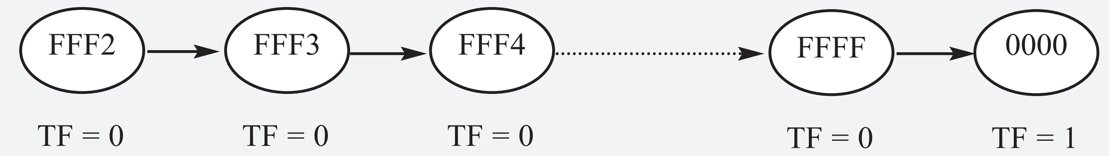
Example 9-4
Solution:
In the above program notice the following steps.
1. TMOD is loaded.
2. FFF2H is loaded into TH0 - TL0.
3. P1.5 is toggled for the high and low portions of the pulse.
4. The DELAY subroutine using the timer is called.
5. In the DELAY subroutine, Timer 0 is started by the “SETB TR0” instruction.
6. Timer 0 counts up with the passing of each clock, which is provided by the crystal oscillator. As the timer counts up, it goes through the states of FFF3, FFF4, FFF5, FFF6, FFF7, FFF8, FFF9, FFFA, FFFB, and so on until it reaches FFFFH. One more clock rolls it to 0, raising the timer flag (TF0 = 1). At that point, the JNB instruction falls through.
7. Timer 0 is stopped by the instruction “CLR TR0”. The DELAY subroutine ends, and the process is repeated.
Notice that to repeat the process, we must reload the TL and TH registers
and start the timer again.

Slide 14
Example 9-5
In Example 9-4, calculate the amount of time delay in the DELAY subroutine generated by the timer. Assume that XTAL = 11.0592 MHz.
Solution:
The timer works with a clock frequency of 1/12 of the XTAL frequency; therefore, we have 11.0592 MHz / 12 = 921.6 kHz as the timer frequency. As a result, each clock has a period of T = 1 / 921.6 kHz = 1.085 75 µs. In other words, Timer 0 counts up each 1.085 75 µs resulting in delay = number of counts x 1.085 75 µs.
The number of counts for the rollover is FFFFH - FFF2H = 0DH (13 decimal). However, we add one to 13 because of the extra clock needed when it rolls over from FFFF to 0 and raises the TF flag. This gives 14 x 1.085 75 µs = 15.19 75 µs for half the pulse. For the entire period T = 2 x 15.19 75 µs = 30.38 75 µs gives us the time delay generated by the timer.

Slide 15
Example 9-6
In Example 9-5, calculate the frequency of the square wave generated on pin P1.5.
Solution:
In the time delay calculation of Example 9-5, we did not include the overhead due to instructions in the loop. To get a more accurate timing, we need to add clock cycles due to the instructions in the loop. To do that, we use the machine cycles from Table A-1 in Appendix A, as shown below.
Cycles
HERE: MOV TL0,#0F2H 2
MOV TH0,#0FFH 2
CPL P1.5 1
ACALL DELAY 2
SJMP HERE 2
;——————————delay using Timer 0
DELAY:
SETB TR0 1
AGAIN: JNB TF0,AGAIN 14
CLR TR0 1
CLR TF0 1
RET 2
Total 28
T = 2 x 28 x 1.085 µs = 60.76 µs and F = 16458.2 Hz.
NOTE THAT 8051 TIMERS USE 1/12 OF XTAL FREQUENCY, REGARDLESS OF
MACHINE CYCLE TIME.

Slide 16
Example 9-7
Find the delay generated by Timer 0 in the following code, using both of the methods of Figure 9-4. Do not include the overhead due to instructions.
CLR P2.3 ;clear P2.3
MOV TMOD,#01 ;Timer 0, mode 1(16-bit mode)
HERE: MOV TL0,#3EH ;TL0 = 3EH, Low byte
MOV TH0,#0B8H ;TH0 = B8H, High byte
SETB P2.3 ;SET high P2.3
SETB TR0 ;start Timer 0
AGAIN: JNB TF0,AGAIN ;monitor Timer 0 flag
CLR TR0 ;stop Timer 0
CLR TF0 ;clear Timer 0 flag for
;next round
CLR P2.3
Solution:
(a) (FFFF - B83E + 1) = 47C2H = 18370 in decimal and 18370 x 1.085 µs = 19.93145 µs.
(b) Since TH - TL = B83EH = 47166 (in decimal) we have 65536 - 47166 = 18370. This means that the timer counts from B83EH to FFFFH. This plus rolling over to 0 goes through a total of 18370 clock cycles, where each clock is 1.085 µs in duration. Therefore, we have 18370 x 1.085 µs = 19.93145 ms as the width of the pulse.

Slide 17
Example 9-8
Modify TL and TH in Example 9-7 to get the largest time delay possible. Find the delay in ms. In your calculation, exclude the overhead due to the instructions in the loop.
Solution:
To get the largest delay we make TL and TH both 0. This will count up from 0000 to FFFFH and then roll over to zero.
CLR P2.3 ;clear P2.3
MOV TMOD,#01 ;Timer 0, mode 1(16-bit mode)
HERE: MOV TL0,#0 ;TL0 = 0, Low byte
MOV TH0,#0 ;TH0 = 0, High byte
SETB P2.3 ;SET P2.3 high
SETB TR0 ;start Timer 0
AGAIN: JNB TF0,AGAIN ;monitor Timer 0 flag
CLR TR0 ;stop Timer 0
CLR TF0 ;clear Timer 0 flag
CLR P2.3
Making TH and TL both zero means that the timer will count from 0000 to FFFFH, and then roll over to raise the TF flag. As a result, it goes through a total of 65536 states. Therefore, we have delay = (65536 - 0) x 1.085µs = 71.1065 ms.

Slide 18
Example 9-9
The following program generates a square wave on pin P1.5 continuously using Timer 1 for a time delay. Find the frequency of the square wave if XTAL = 11.0592 MHz. In your calculation do not include the overhead due to instructions in the loop.
MOV TMOD,#10H ;Timer 1, mode 1(16-bit)
AGAIN: MOV TL1,#34H ;TL1 = 34H, Low byte
MOV TH1,#76H ;TH1 = 76H, High byte
;(7634H = timer value)
SETB TR1 ;start Timer 1
BACK: JNB TF1,BACK ;stay until timer rolls over
CLR TR1 ;stop Timer 1
CPL P1.5 ;comp. P1.5 to get hi, lo
CLR TF1 ;clear Timer 1 flag
SJMP AGAIN ;reload timer since Mode 1

Slide 19
Example 9-9
Solution:
In the above program notice the target of SJMP. In mode 1, the program must reload the TH, TL register every time if we want to have a continuous wave. Now the calculation.
Since FFFFH - 7634H = 89CBH + 1 = 89CCH and 89CCH = 35276 clock count.
35276 x 1.085 µs = 38.274 ms for half of the square wave. The entire square wave length is 38.274 x 2 = 76.548 ms and has a frequency = 13.064 Hz.
Also notice that the high and low portions of the square wave pulse are equal. In the above calculation, the overhead due to all the instructions in the loop is not included.

Slide 20
Example 9-10
Assume that XTAL = 11.0592 MHz. What value do we need to load into the timer’s registers if we want to have a time delay of 5 ms(milliseconds)? Show the program for Timer 0 to create a pulse width of 5 ms on P2.3.
Solution:
Since XTAL = 11.0592 MHz, the counter counts up every 1.085 µs. This means that out of many 1.085 µs intervals we must make a 5 ms pulse. To get that, we divide one by the other. We need 5 ms / 1.085 µs = 4608 clocks. To achieve that we need to load into TL and TH the value 65536 - 4608 = 60928 = EE00H. Therefore, we have TH = EE and TL = 00.
CLR P2.3 ;clear P2.3
MOV TMOD,#01 ;Timer 0, mode 1 (16-bit mode)
HERE: MOV TL0,#0 ;TL0 = 0, Low byte
MOV TH0,#0EEH ;TH0 = EE( hex), High byte
SETB P2.3 ;SET P2.3 high
SETB TR0 ;start Timer 0
AGAIN: JNB TF0,AGAIN ;monitor Timer 0 flag
;until it rolls over
CLR P2.3 ;clear P2.3
CLR TR0 ;stop Timer 0
CLR TF0 ;clear Timer 0 flag

Slide 21
Example 9-11
Assuming that XTAL = 11.0592 MHz, write a program to generate a square wave of 2 kHz frequency on pin P1.5.
Solution:
This is similar to Example 9-10, except that we must toggle the bit to generate the square wave. Look at the following steps.
(a) T = 1 / f = 1 / 2 kHz = 500 µs the period of the square wave.
(b) 1/2 of it for the high and low portions of the pulse is 250 µs.
(c) 250 µs / 1.085 µs = 230 and 65536 - 230 = 65306, which in hex is FF1AH.
(d) TL = 1AH and TH = FFH, all in hex. The program is as follows.
MOV TMOD,#10H ;Timer 1, mode 1(16-bit)
AGAIN: MOV TL1,#1AH ;TL1=1AH, Low byte
MOV TH1,#0FFH ;TH1=FFH, High byte
SETB TR1 ;start Timer 1
BACK: JNB TF1,BACK ;stay until timer rolls over
CLR TR1 ;stop Timer 1
CPL P1.5 ;complement P1.5 to get hi, lo
CLR TF1 ;clear Timer 1 flag
SJMP AGAIN ;reload timer since mode 1
;is not auto-reload

Slide 22
Example 9-12
Assuming XTAL = 11.0592 MHz, write a program to generate a square wave of 50 Hz frequency on pin P2.3.
Solution:
Look at the following steps.
(a) T = 1 / 50 Hz = 20 ms, the period of the square wave.
(b) 1/2 of it for the high and low portions of the pulse = 10 ms
(c) 10 ms / 1.085 µs = 9216 and 65536 - 9216 = 56320 in decimal, and in hex it is DC00H.
(d) TL = 00 and TH = DC (hex)
The program follows.
MOV TMOD,#10H ;Timer 1, mode 1 (16-bit)
AGAIN: MOV TL1,#00 ;TL1 = 00, Low byte
MOV TH1,#0DCH ;TH1 = DCH, High byte
SETB TR1 ;start Timer 1
BACK: JNB TF1,BACK ;stay until timer rolls over
CLR TR1 ;stop Timer 1
CPL P2.3 ;comp. P2.3 to get hi, lo
CLR TF1 ;clear Timer 1 flag
SJMP AGAIN ;reload timer since mode 1
;is not auto-reload

Slide 23
Example 9-13
Examine the following program and find the time delay in seconds. Exclude the overhead due to the instructions in the loop.
MOV TMOD,#10H ;Timer 1, mode 1(16-bit)
MOV R3,#200 ;counter for multiple delay
AGAIN: MOV TL1,#08H ;TL1 = 08, Low byte
MOV TH1,#01H ;TH1 = 01, High byte
SETB TR1 ;start Timer 1
BACK: JNB TF1,BACK ;stay until timer rolls over
CLR TR1 ;stop Timer 1
CLR TF1 ;clear Timer 1 flag
DJNZ R3,AGAIN ;if R3 not zero then
;reload timer
Solution:
TH - TL = 0108H = 264 in decimal and 65536 - 264 = 65272. Now 65272 x 1.085 µs = 70.820 ms, and for 200 of them we have 200 x 70.820 ms = 14.164024 seconds.

Slide 24
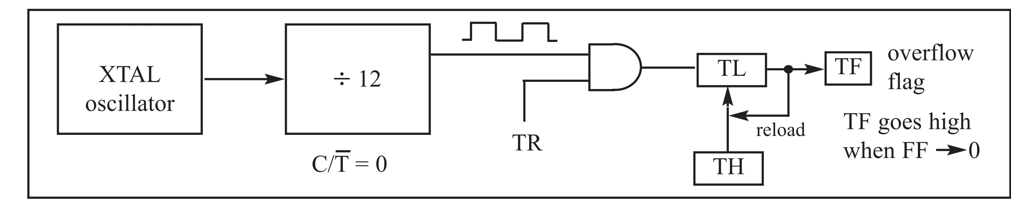
Mode 2 programming

Slide 25
Example 9-14
Assuming that XTAL = 11.0592 MHz, find (a) the frequency of the square wave generated on pin P1.0 in the following program, and (b) the smallest frequency achievable in this program, and the TH value to do that.
MOV TMOD,#20H ;T1/mode 2/8-bit/auto-reload
MOV TH1,#5 ;TH1 = 5
SETB TR1 ;start Timer 1
BACK: JNB TF1,BACK ;stay until timer rolls over
CPL P1.0 ;comp. P1.0 to get hi, lo
CLR TF1 ;clear Timer 1 flag
SJMP BACK ;mode 2 is auto-reload
Solution:
Solution:
(a) First notice the target address of SJMP. In mode 2 we do not need to reload TH since it is auto-reload. Now (256 - 05) x 1.085 µs = 251 x 1.085 µs = 272.33 µs is the high portion of the pulse. Since it is a 50% duty cycle square wave, the period T is twice that; as a result T = 2 x 272.33 µs = 544.67 µs and the frequency = 1.83597 kHz.
(b) To get the smallest frequency, we need the largest T and that is achieved when TH = 00. In that case, we have T = 2 x 256 x 1.085 µs = 555.52 µs and the frequency = 1.8 kHz.

Slide 26
Example 9-15
Find the frequency of a square wave generated on pin P1.0.
Solution:
MOV TMOD,#2H ;Timer 0, mode 2
;(8-bit, auto-reload)
MOV TH0,#0 ;TH0=0
AGAIN: MOV R5,#250 ;count for multiple delay
ACALL DELAY
CPL P1.0 ;toggle P1.0
SJMP AGAIN ;repeat
DELAY: SETB TR0 ;start Timer 0
BACK: JNB TF0,BACK ;stay until timer rolls over
CLR TR0 ;stop Timer 0
CLR TF0 ;clear TF for next round
DJNZ R5,DELAY
RET
T = 2 (250 x 256 x 1.085 µs) = 138.88 ms, and frequency = 72 Hz.

Slide 27
Example 9-16
Assuming that we are programming the timers for mode 2, find the value (in hex) loaded into TH for each of the following cases.
(a) MOV TH1,#-200 (b) MOV TH0,#-60
(c) MOV TH1,#-3 (d) MOV TH1,#-12
(e) MOV TH0,#-48
Solution:
You can use the Windows scientific calculator to verify the results provided by the assembler. In Windows calculator, select decimal and enter 200. Then select hex, then +/- to get the TH value. Remember that we only use the right two digits and ignore the rest since our data is an 8-bit data. The following is what we get.
Decimal 2’s complement (TH value)
-200 38H
-60 C4H
-3 FDH
-12 F4H
-48 D0H

Slide 28
Example 9-17
Find (a) the frequency of the square wave generated in the following code, and (b) the duty cycle of this wave.
MOV TMOD,#2H ;Timer 0, mode 2
;(8-bit, auto-reload)
MOV TH0,#-150 ;TH0 = 6AH = 2’s comp of -150
AGAIN: SETB P1.3 ;P1.3 = 1
ACALL DELAY
ACALL DELAY
CLR P1.3 ;P1.3 = 0
ACALL DELAY
SJMP AGAIN
DELAY:
SETB TR0 ;start Timer 0
BACK: JNB TF0,BACK ;stay until timer rolls over
CLR TR0 ;stop Timer 0
CLR TF0 ;clear TF for next round
RET
Solution:
For the TH value in mode 2, the conversion is done by the assembler as long as we enter a negative number. This also makes the calculation easy. Since we are using 150 clocks, we have time for the DELAY subroutine = 150 x 1.085 µs = 162 µs. The high portion of the pulse is twice that of the low portion (66% duty cycle). Therefore, we have: T = high portion + low portion = 325.5 µs + 162.25 µs = 488.25 µs and frequency = 2.048 kHz.

Slide 29
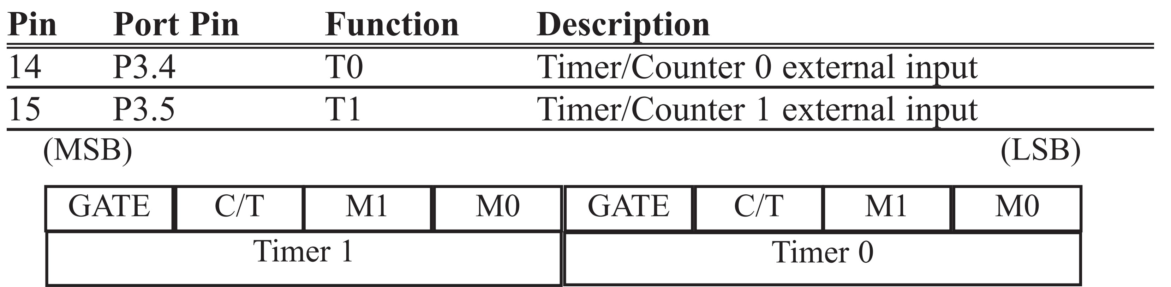
Table 9-1: Port 3 Pins Used For Timers 0 and 1

Slide 30
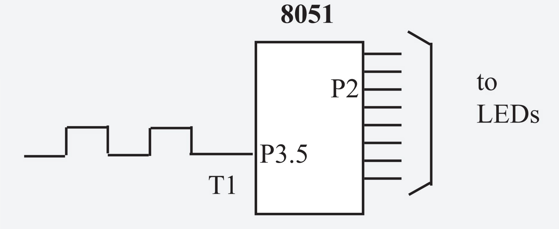
Example 9-18
Assuming that clock pulses are fed into pin T1, write a program for counter 1 in mode 2 to count the pulses and display the state of the TL1 count on P2.
Solution:
Notice in the above program the role of the instruction “SETB P3.5”. Although ports are set up for input when the 8051 is powered up, we still make P3.5 an input port (by making it high) to make sure it is an input since some other programs could have used it as an output. In other words, we must configure (set high) the T1 pin (pin P3.5) to allow pulses to be fed into it.
MOV TMOD,#01100000B ;counter 1, mode 2,C/T=1
;external pulses
MOV TH1,#0 ;clear TH1
SETB P3.5 ;make T1 input
AGAIN: SETB TR1 ;start the counter
BACK: MOV A,TL1 ;get copy of count TL1
MOV P2,A ;display it on port 2
JNB TF1,BACK ;keep doing it if TF=0
CLR TR1 ;stop the counter 1
CLR TF1 ;make TF=0
SJMP AGAIN ;keep doing it
P2 is connected to 8 LEDs and input T1 to pulse.

Slide 31
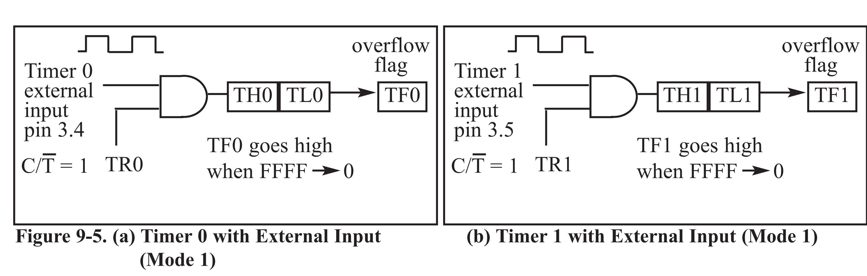
Figure 9-5
(a) Timer 0 with External Input (Mode 1)
(b) Timer 1 with External Input (Mode 1)

Slide 32
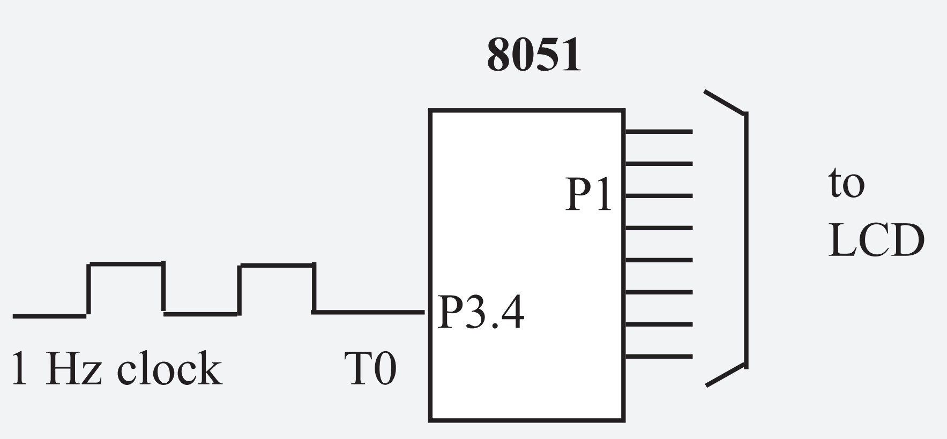
Assume that a 1-Hz frequency pulse is connected to input pin 3.4. Write a program to display counter 0 on an LCD. Set the initial value of TH0 to -60.
Example 9-19
Solution:
ACALL LCD_SET_UP ;initialize the LCD
MOV TMOD,#00000110B ;counter 0,mode 2,C/T=1
MOV TH0,#-60 ;counting 60 pulses
SETB P3.4 ;make T0 as input
AGAIN: SETB TR0 ;starts the counter
BACK: MOV A,TL0 ;get copy of count TL0
ACALL CONV ;convert in R2, R3, R4
ACALL DISPLAY ;display on LCD
JNB TF0,BACK ;loop if TF0=0
CLR TR0 ;stop the counter 0
CLR TF0 ;make TF0=0
SJMP AGAIN ;keep doing it
;converting 8-bit binary to ASCII
;upon return, R4, R3, R2 have ASCII data (R2 has LSD)
CONV: MOV B,#10 ;divide by 10
DIV AB
MOV R2,B ;save low digit
MOV B,#10 ;divide by 10 once more
DIV AB
ORL A,#30H ;make it ASCII
MOV R4,A ;save MSD
MOV A,B
ORL A,#30H ;make 2nd digit an ASCII
MOV R3,A ;save it
MOV A,R2
ORL A,#30H ;make 3rd digit an ASCII
MOV R2,A ;save the ASCII
RET
To display the TL count on an LCD, we must convert 8-bit binary data to ASCII. See Chapter 6 for data conversion.
By using 60 Hz we can generate seconds, minutes, hours.
Note that on the first round, it starts from 0, since on RESET, TL0 = 0.
To solve this problem, load TL0 with -60 at the beginning of the program.

Slide 33
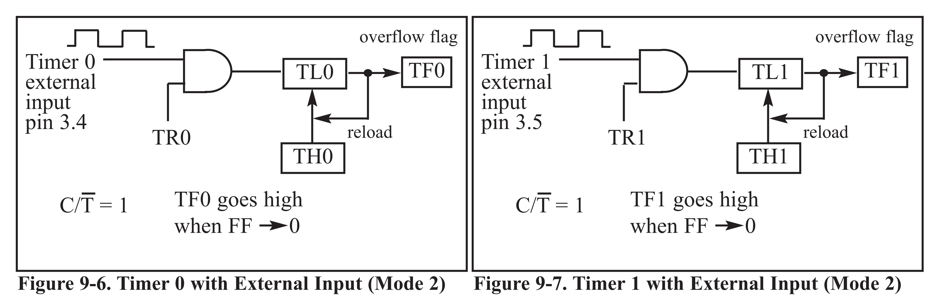
Figure 9-6. Timer 0 with External Input (Mode 2)
Figure 9-7. Timer 1 with External Input (Mode 2)

Slide 34
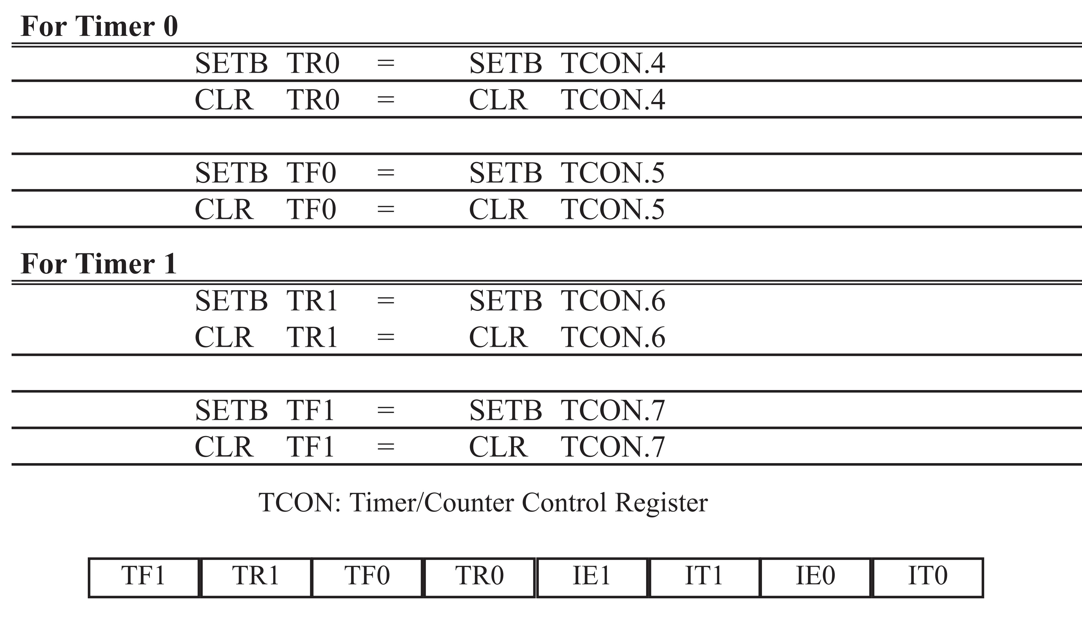
Table 9-2: Equivalent Instructions for the Timer Control Register (TCON)

Slide 35
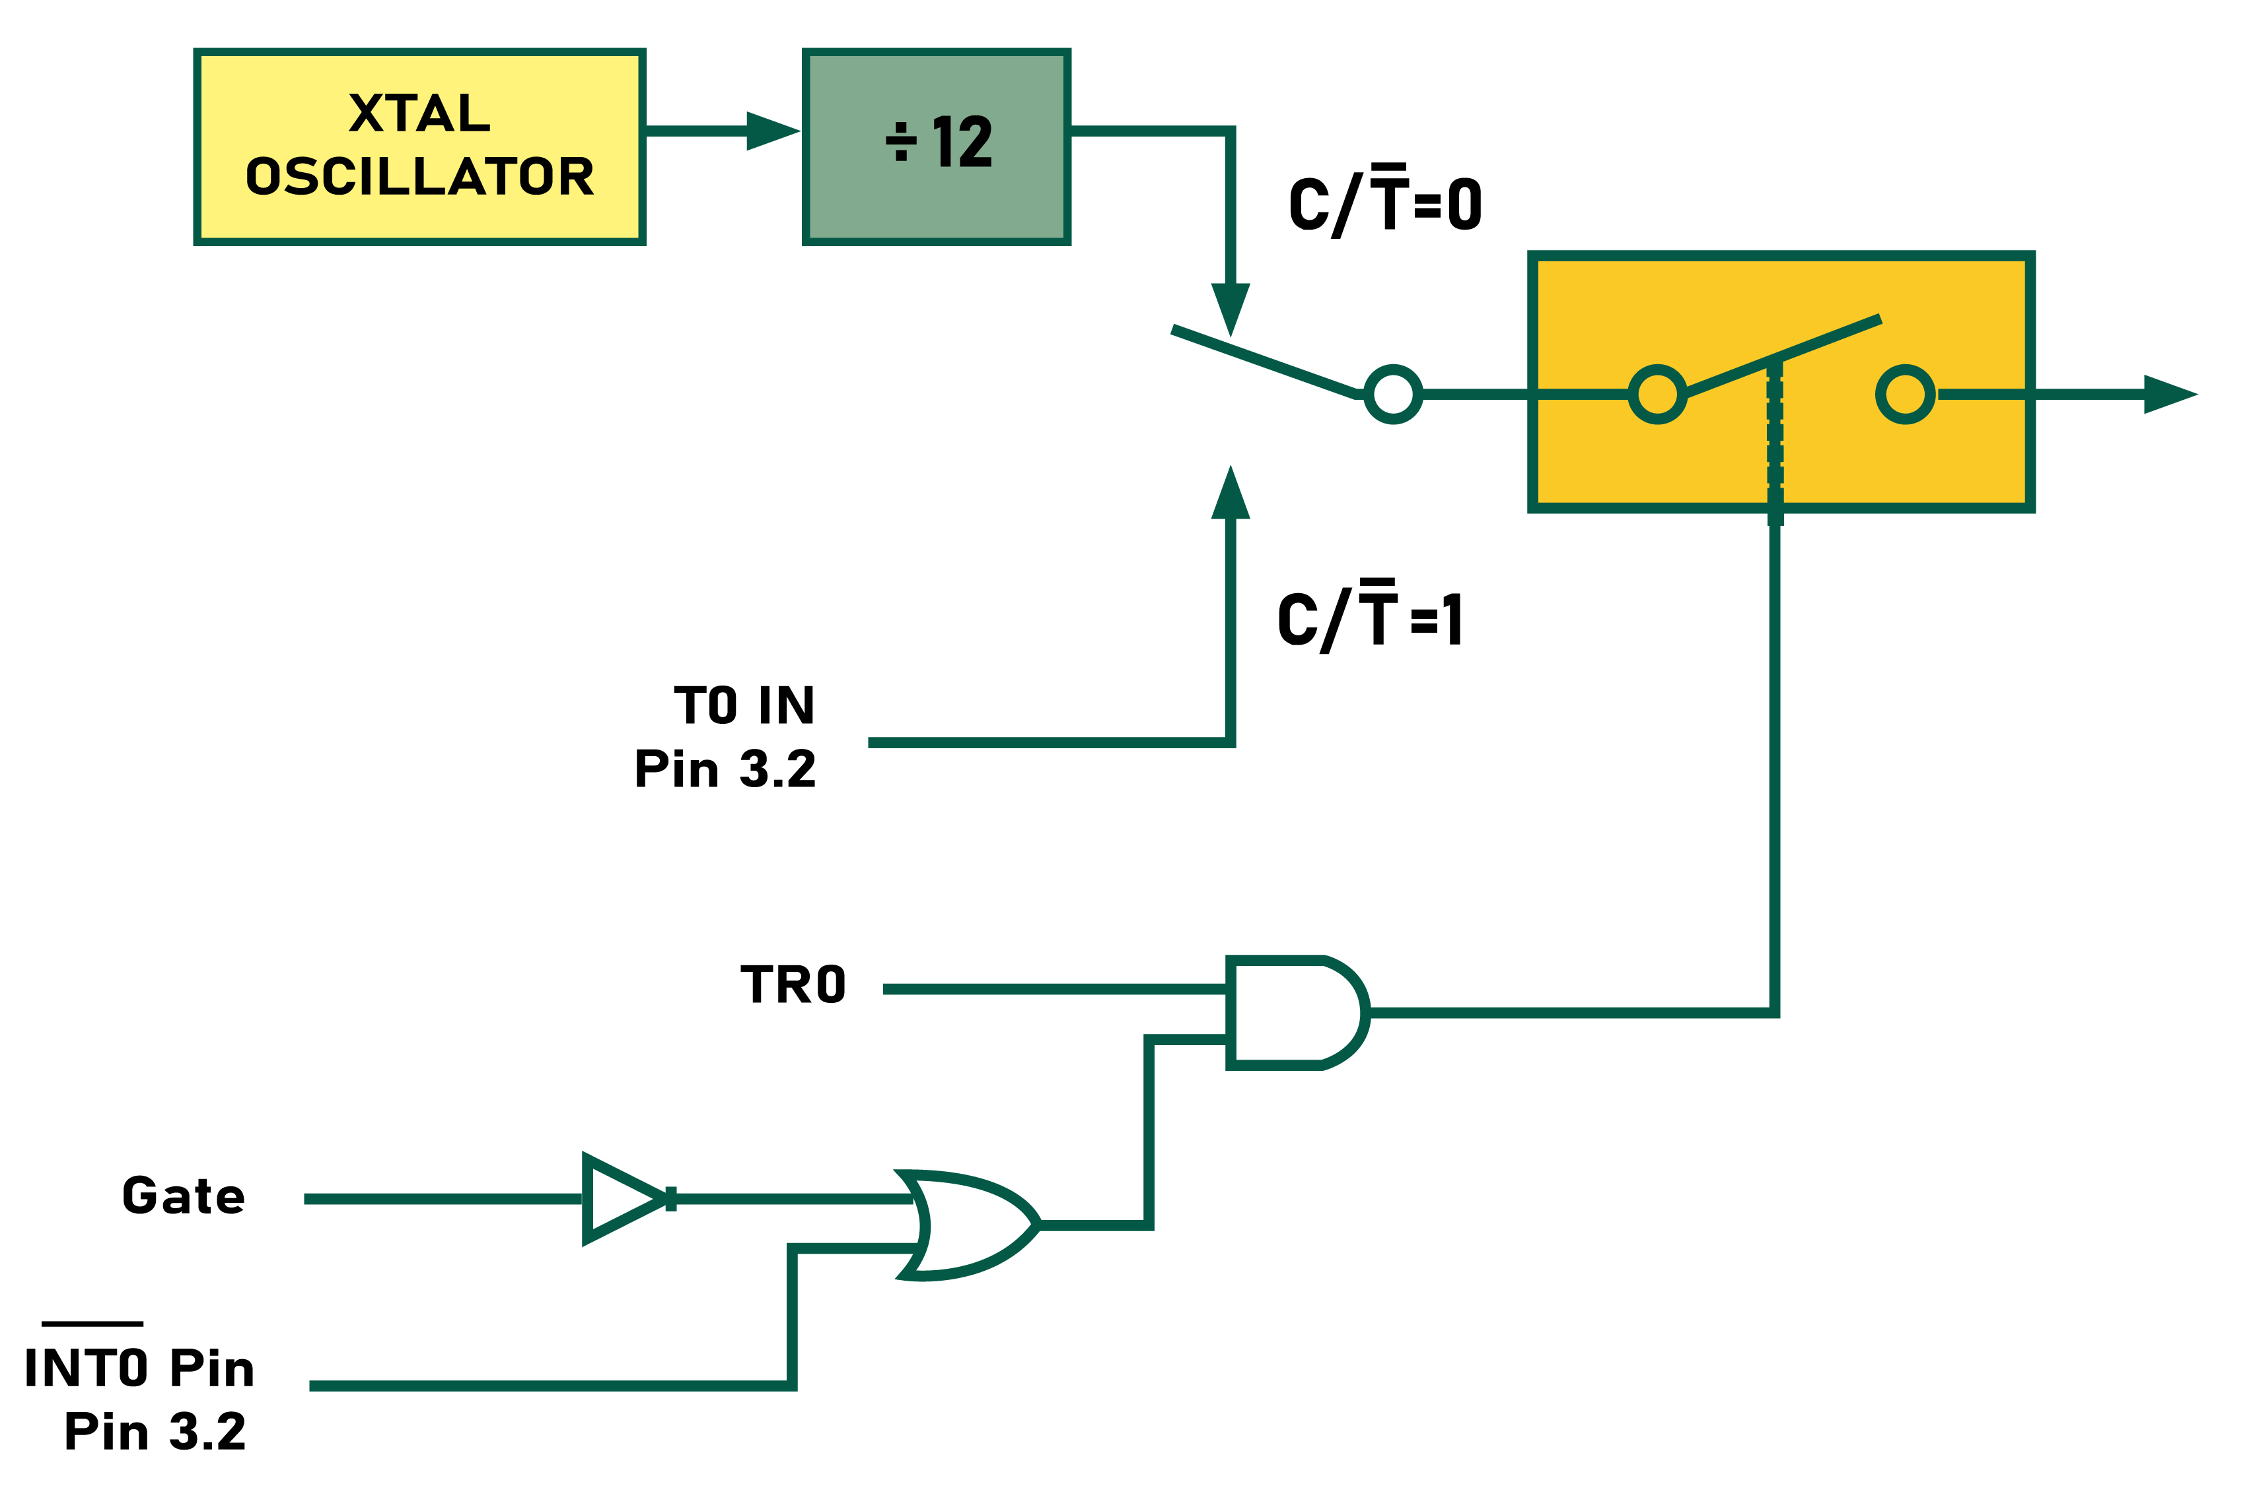
Figure 9-8. Timer/Counter 0

Slide 36

Figure 9-9. Timer/Counter 1

Slide 37
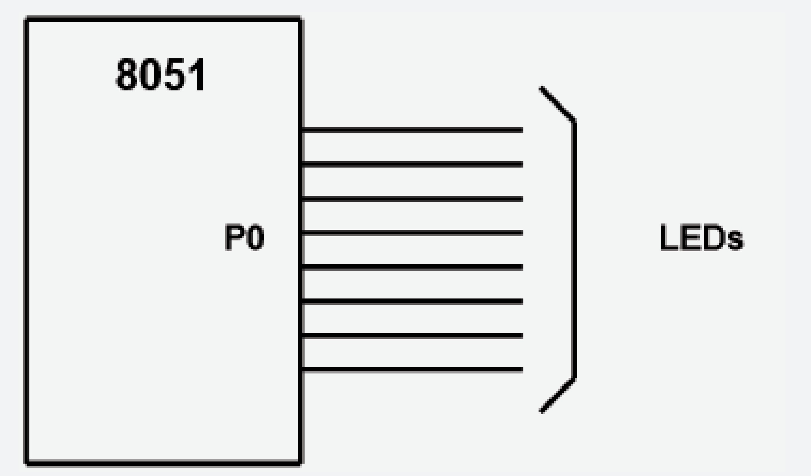
Write a 8051 C program to toggle all the bits of port P1 continuously with some delay in between. Use Timer 0, 16-bit mode to generate the delay.
Example 9-20
Solution:
#include <reg51.h>
void T0Delay(void);
void main(void)
{
while(1) //repeat forever
{
P1=0x55; //toggle all bits of P1
T0Delay(); //delay size unknown
P1=0xAA; //toggle all bits of P1
T0Delay();
}
}
void T0Delay()
{
TMOD=0x01; //Timer 0, Mode 1
TL0=0x00; //load TL0
TH0=0x35; //load TH0
TR0=1; //turn on T0
while(TF0==0); //wait for TF0 to roll over
TR0=0; //turn off T0
TF0=0; //clear TF0
}
FFFFH – 3500H = CAFFH = 51967 + 1 = 51968
51968 x 1.085 µs = 56.384 ms is the approximate delay.

Slide 38
Write an 8051 C program to toggle only bit P1.5 continuously every 50 ms. Use Timer 0, mode 1 (16-bit) to create the delay. Test the program (a) on the AT89C51 and (b) on the DS89C4x0.
Example 9-21
Solution:
#include <reg51.h>
void T0M1Delay(void);
sbit mybit=P1^5;
void main(void)
{
while(1)
{
mybit=~mybit; //toggle P1.5
T0M1Delay(); //Timer 0, mode 1(16-bit)
}
}
(a) Tested for AT89C51, XTAL=11.0592 MHz, using the Proview32 compiler
void T0M1Delay(void)
{
TMOD=0x01; //Timer 0, mode 1(16-bit)
TL0=0xFD; //load TL0
TH0=0x4B; //load TH0
TR0=1; //turn on T0
while(TF0==0);//wait for TF0 to roll over
TR0=0; //turn off T0
TF0=0; //clear TF0
}
(b) Tested for DS89C4x0, XTAL=11.0592 MHz, using the Proview32 compiler
void T0M1Delay(void)
{
TMOD=0x01; //Timer 0, mode 1(16-bit)
TL0=0xFD; //load TL0
TH0=0x4B; //load TH0
TR0=1; //turn on T0
while(TF0==0); //wait for TF0 to roll over
TR0=0; //turn off T0
TF0=0; //clear TF0
}
FFFFH – 4BFDH = B402H = 46082 + 1 = 46083
Timer delay = 46083 x 1.085 µs = 50 ms

Slide 39
Write an 8051 C program to toggle all bits of P2 continuously every 500 ms. Use Timer 1, mode 1 to create the delay.
Example 9-22
Solution:
#include <reg51.h>
void T1M1Delay(void);
void main(void)
{
unsigned char x;
P2=0x55;
while(1)
{
P2=~P2; //toggle all bits of P2
for(x=0;x<20;x++)
T1M1Delay();
}
}
void T1M1Delay(void)
{
TMOD=0x10; //Timer 1, mode 1(16-bit)
TL1=0xFE; //load TL1
TH1=0xA5; //load TH1
TR1=1; //turn on T1
while(TF1==0); //wait for TF1 to roll over
TR1=0; //turn off T1
TF1=0; //clear TF1
}
//tested for DS89C4x0, XTAL = 11.0592 MHz, using the Proview32 compiler
A5FEH = 42494 in decimal
65536 – 42494 = 23042
23042 x 1.085 µs = 25 ms and 20 x 25 ms = 500 ms
NOTE THAT 8051 TIMERS USE 1/12 OF XTAL FREQUENCY, REGARDLESS OF MACHINE CYCLE TIME.

Slide 40
Write an 8051 C program to toggle only pin P1.5 continuously every 250 ms. Use Timer 0, mode 2 (8-bit auto-reload) to create the delay.
Example 9-23
Solution:
#include <reg51.h>
void T0M2Delay(void);
sbit mybit=P1^5;
void main(void)
{
unsigned char x, y;
while(1)
{
mybit=~mybit; //toggle P1.5
for(x=0;x<250;x++) //due to for loop overhead
for(y=0;y<36;y++) //we put 36 and not 40
T0M2Delay();
}
}
void T0M2Delay(void)
{
TMOD=0x02; //Timer 0, mode 2(8-bit auto-reload)
TH0=-23; //load TH0(auto-reload value)
TR0=1; //turn on T0
while(TF0==0); //wait for TF0 to roll over
TR0=0; //turn off T0
TF0=0; //clear TF0
}
//tested for DS89C4x0, XTAL = 11.0592 MHz, using the Proview32 compiler
256 – 23 = 233
23 x 1.085 µs = 25 µs
25 µs x 250 x 40 = 250 ms by calculation.
However, the scope output does not give us this result. This is due to overhead of the for loop in C. To correct this problem, we put 36 instead of 40.

Slide 41
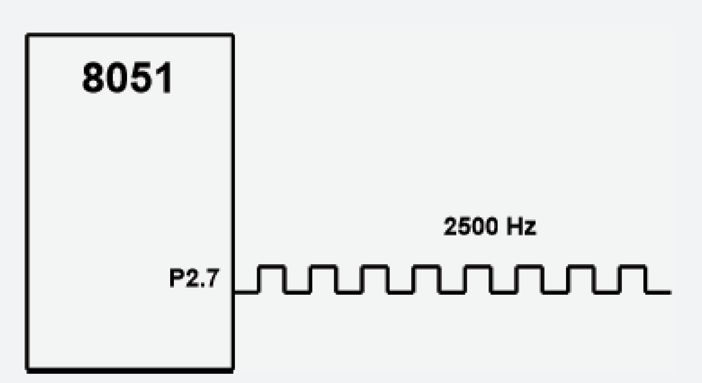
Write an 8051 C program to create a frequency of 2500 Hz on pin P2.7. Use Timer 1, mode 2 to create the delay.
Example 9-24
Solution:
#include <reg51.h>
void T1M2Delay(void);
sbit mybit=P2^7;
void main(void)
{
unsigned char x;
while(1)
{
mybit=~mybit; //toggle P2.7
T1M2Delay();
}
}
void T1M2Delay(void)
{
TMOD=0x20; //Timer 1, mode 2(8-bit auto-reload)
TH1=-184; //load TH1(auto-reload value)
TR1=1; //turn on T1
while(TF1==0); //wait for TF1 to roll over
TR1=0; //turn off T1
TF1=0; //clear TF1
}
//tested for DS89C4x0, XTAL = 11.0592 MHz, using the Proview32 compiler
1 / 2500 Hz = 400 µs
400 µs / 2 = 200 µs
200 µs / 1.085 µs = 184

Slide 42
A switch is connected to pin P1.2. Write an 8051 C program to monitor SW and create the following frequencies on pin P1.7:
SW=0: 500 Hz SW=1: 750 Hz Use Timer 0, mode 1 for both of them.
Example 9-25
Solution:
#include <reg51.h>
sbit mybit=P1^5;
sbit SW=P1^7;
void T0M1Delay(unsigned char);
void main(void)
{
SW=1; //make P1.7 an input
while(1)
{
mybit=~mybit; //toggle P1.5
if(SW==0) //check switch
T0M1Delay(0);
else
T0M1Delay(1);
}
}
void T0M1Delay(unsigned char c)
{
TMOD=0x01;
if(c==0)
{
TL0=0x67; //FC67
TH0=0xFC;
}
else
{
TL0=0x9A; //FD9A
TH0=0xFD;
}
TR0=1;
while(TF0==0);
TR0=0;
TF0=0;
}
//tested for AT89C51/52, XTAL = 11.0592 MHz, using the Proview32 compiler
FC67H = 64615
65536 – 64615 = 921
921 x 1.085 µs = 999.285 µs
1 / (999.285 µs x 2) = 500 Hz

Slide 43
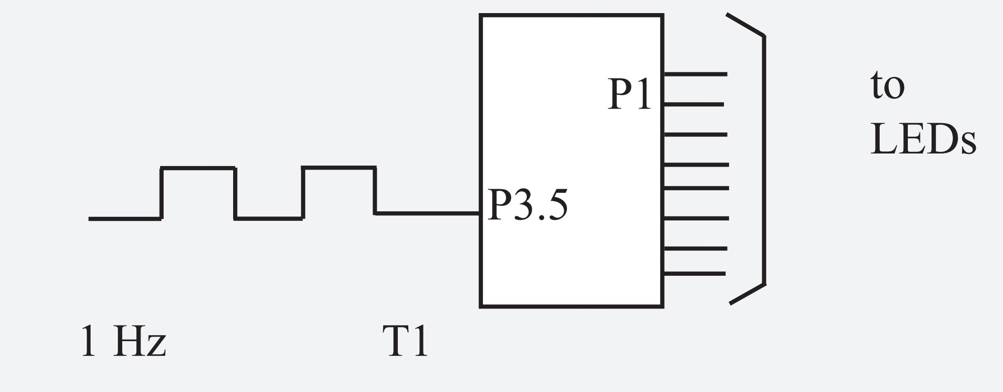
Assume that a 1-Hz external clock is being fed into pin T1 (P3.5). Write a C program for counter 1 in mode 2 (8-bit auto reload) to count up and display the state of the TL1 count on P1. Start the count at 0H.
Example 9-26
Solution:
#include <reg51.h>
sbit T1 = P3^5;
void main(void)
{
T1=1; //make T1 an input
TMOD=0x60; //
TH1=0; //set count to 0
while(1) //repeat forever
{
do
{
TR1=1; //start timer
P1=TL1; //place value on pins
}
while(TF1==0); //wait here
TR1=0; //stop timer
TF1=0; //clear flag
}
}
P1 is connected to 8 LEDs.
T1 (P3.5) is connected to a
1-Hz external clock.

Slide 44
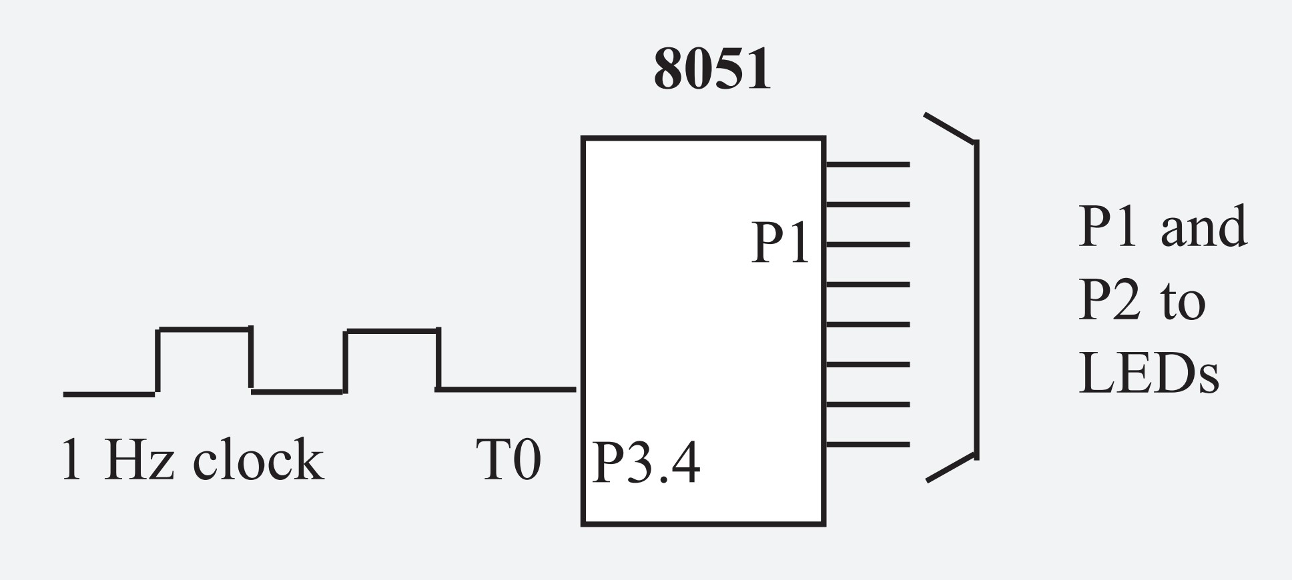
Example 9-27
Assume that a 1-Hz external clock is being fed into pin T0 (P3.4). Write a C program for counter 0 in mode 1 (16-bit) to count the pulses and display the TH0 and TL0 registers on P2 and P1, respectively.
Solution:
#include <reg51.h>
void main(void)
{
T0=1; //make T0 an input
TMOD=0x05; //
TL0=0; //set count to 0
TH0=0; //set count to 0
while(1) //repeat forever
{
do
{
TR0=1; //start timer
P1=TL0; //place value on pins
P2=TH0; //
}
while(TF0==0); //wait here
TR0=0; //stop timer
TF0=0;
}
}

Slide 45
Assume that a 2-Hz external clock is being fed into pin T1 (P3.5). Write a C program for counter 0 in mode 2 (8-bit auto reload) to display the count in ASCII. The 8-bit binary count must be converted to ASCII. Display the ASCII digits (in binary) on P0, P1, and P2 where P0 has the least significant digit.
Set the initial value of TH0 to 0.
Example 9-28
Solution:
To display the TL1 count we must convert 8-bit binary data to ASCII. See Chapter 7 for data conversion. The ASCII values will be shown in binary. For example, ‘9’ will show as 00111001 on ports.
#include <reg51.h>
void BinToASCII(unsigned char);
void main()
{
unsigned char value;
T1=1;
TMOD=0x06;
TH0=0;
while(1)
{
do
{
TR0=1;
value=TL0;
BinToASCII(value);
}
while(TF0==0);
TR0=0;
TF0=0;
}
}
void BinToASCII(unsigned char value) //see Chapter 7
{
unsigned char x,d1,d2,d3;
x = value / 10;
d1 = value % 10
d2 = x % 10;
d3 = x / 10
P0 = 30 | d1;
P1 = 30 | d2;
P2 = 30 | d3
}

Slide 46
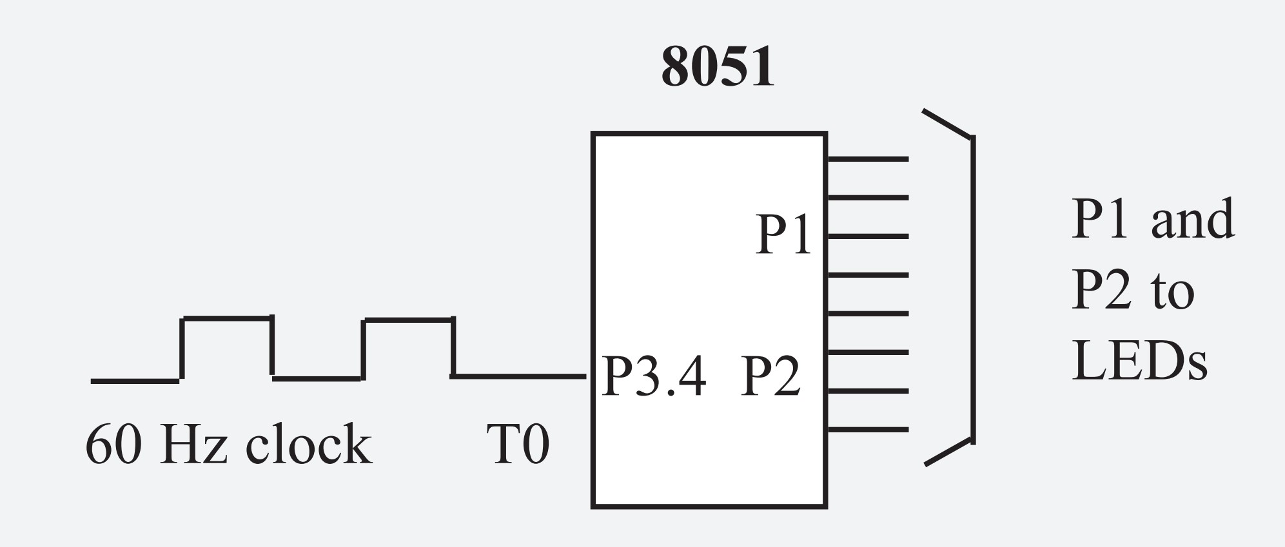
Assume that a 60-Hz external clock is being fed into pin T0 (P3.4).
Write a C program for counter 0 in mode 2 (8-bit auto-reload)
to display the seconds and minutes on P1 and P2, respectively.
Example 9-29
Solution:
#include <reg51.h>
void ToTime(unsigned char);
void main()
{
unsigned char val;
T0=1;
TMOD=0x06; //T0, mode 2, counter
TH0=-60; //sec = 60 pulses
while(1)
{
do
{
TR0=1;
sec=TL0;
ToTime(val);
}
while(TF0==0);
TR0=0;
TF0=0;
}
}
void ToTime(unsigned char val)
{
unsigned char sec, min;
min = value / 60;
sec = value % 60;
P1 = sec;
P2 = min;
}
By using 60 Hz, we can generate
seconds, minutes, hours.

